Slide 1
Supervised Classification of the Golan Height
Ryan Olsen

Slide 2
Why this area?
Desert area that has ongoing development.
Conflict area.

Slide 3
Historical highlights of the Golan Heights region
1923 - Paulet-Newcombe Agreement established border between Palestine and Iraq.
14 May 1948 - British Palestine declares independence forming the state of Israel.
15 May 1948 – Start of First Arab-Israeli war, ends 10 March 1949
5-10 June 1967 – Six Day War, Israeli invades and occupies the Golan Heights region, gaining ~1150km² of territory from Syria.
17 December 1981 – UN resolution 497 declare the Israeli Golan Heights Law that annexed the Golan Heights illegal and calls for Israel to rescind the action, i.e. cede the territory back to Syria
Ongoing – Israeli builds illegal settlements in the region.

Slide 4
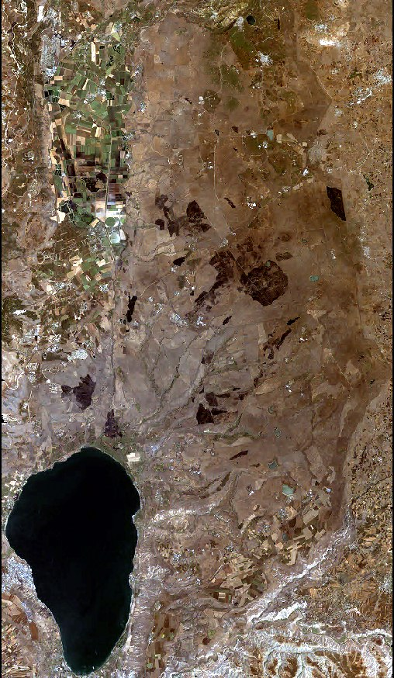
Golan Heights LandSat 7 image take 6-9-01
True color

Slide 5
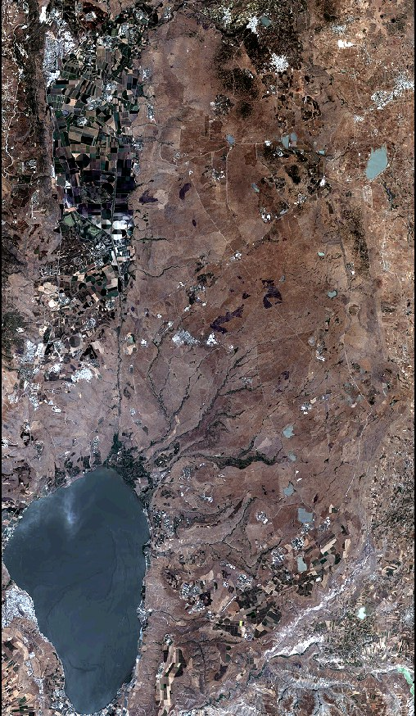
Golan Heights LandSat 8 image take 6-8-01
True color

Slide 6
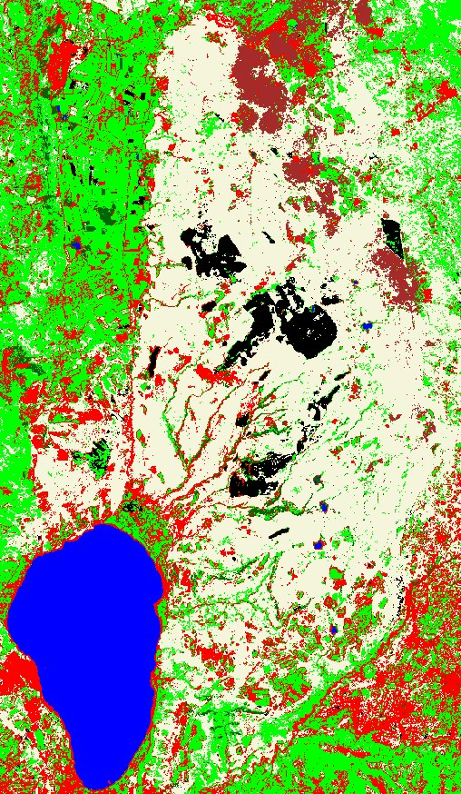
Golan Heights LandSat 7 image taken 6-8-01
Supervised classification
Classes:
Water
Built-up area
Barren land
Range land
Agriculture
Burned land
Wetland

Slide 7
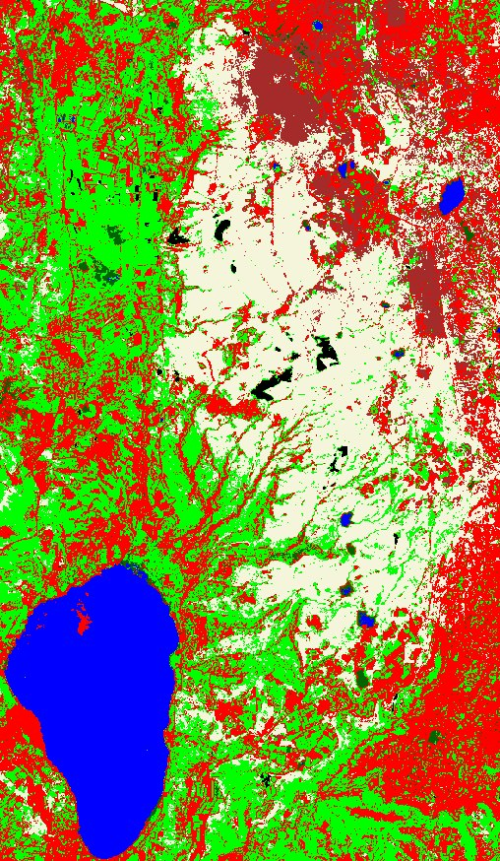
Golan Heights LandSat 8 image taken 6-9-21
Supervised classification
Classes:
Water
Built-up area
Barren land
Range land
Agriculture
Burned land
Wetland

Slide 8
Disadvantage of classification method
The area is desert, classification of urbanized/built-up areas can be difficult due to collection of dust on flat surfaces (buildings, roads, etc.)
I chose too large of an area to be very detailed in training classes (35.35km x 60.83km).
I used too few classes.

Slide 9
Conclusion
There has been extensive agricultural development in the Golan Heights region even though the supervised classification was faulty.
It is extremely likely that Israel will continue to illegally develop the region for agriculture.

